Slide 1
Distributed Computing(9)
Simple Object Access Protocol (SOAP)

Slide 2

Topics
Web Services Basics
Simple Object Access Protocol

Slide 3
Web Services
Web services are web-based enterprise applications that use open, XML-based standards and transport protocols to exchange data with calling clients .
Aplication
Aplication
service discovery
UDDI (Universal Description,
Discovery, and Integration
service discovery
service description
service description
WSDL (Web Service Description Language)
messaging
XML, SOAP( Simple Object Access Protocol)
messaging
transport
TCP, HTTP, SMTP
transport
network
IP
network

Slide 4
Web Services Protocols
XML
  XML is a cross-platform, extensible, text-based standard for representing data.
SOAP
  SOAP is an XML-based protocol that follows the HTTP request-and-response model
WSDL
  standardized XML format for describing network services. The description includes the name of the service, the location of the service, and ways to communicate with the service.
UDDI
  for businesses to publish information on the Internet about their web services, where the information can be readily and globally accessed by clients who want to do business.

Slide 5
SOAP
Simple Object Access Protocol
SOAP is a protocol that incorporates the distributed objects paradigm and internet protocols, specially a protocol that extends HTTP to allow access to distributed objects that represent web services.
Methord name, parameter list
Web
Client
Web Server
Service
Object
Returned value

Slide 6
SOAP Message
SOAP Messages are encoded in XML.
Envelope
  Header
  Body
SOAP Envelope
SOAP Header
(Optional)
Header Block
SOAP Body
(Required)
Message Body

Slide 7
SOAP Request
POST /SimpleService/services/HelloWorld HTTP/1.0
Content-Type: text/xml; charset=utf-8
Host: 127.0.0.1:8082
SOAPAction: ""
Content-Length: 378
<?xml version="1.0" encoding="UTF-8"?>
<soapenv:Envelope xmlns:soapenv="http://schemas.xmlsoap.org/soap/envelope/" xmlns:xsd="http://www.w3.org/2001/XMLSchema" xmlns:xsi="http://www.w3.org/2001/XMLSchema-instance">
<soapenv:Body>
<ns1:sayHello soapenv:encodingStyle="http://schemas.xmlsoap.org/soap/encoding/" xmlns:ns1="http://soapinterop.org/"/>
</soapenv:Body>
</soapenv:Envelope>

Slide 8
SOAP HTTP Request
POST: the HTTP binding defined in the SOAP specification requires the use of the POST method.
Content-Type: All SOAP messages must be sent using text/xml.
SOAPAction: required for all SOAP request messages transported using HTTP. It provides some information to the HTTP server in the form of a URI that indicates the intent of the message.

Slide 9
The SOAP Envelope
The Envelope Element
  The Envelope is the topmost element of the XML document that represents the SOAP message.
<soapenv:Envelope xmlns:soapenv=http://schemas.xmlsoap.org/soap/envelope/
xmlns:xsd="http://www.w3.org/2001/XMLSchema"
xmlns:xsi="http://www.w3.org/2001/XMLSchema-instance">
<soapenv:Header>
</soapenv:Header>
<soapenv:Body>
</soapenv:Body>
</soapenv:Envelope>

Slide 10
The Header Element
The Header Element
  The SOAP header is optional. If it is present, it must be named Header and be the first subelement of the Envelope element.
  the Header entries are used to encode elements used for transaction processing, authentication, or other information related to the processing or routing of the message.
<soapenv:Header>
<ns1:username xmlns:ns1="JavaSoapBook"
soapenv:actor="http://www.mindstrm.com/AppServer"
soapenv:mustUnderstand="1">
Jessica
</ns1:username>
</soapenv:Header>

Slide 11
The Body Element
The SOAP Body element is mandatory in SOAP, If there is no SOAP header, the Body must be the first subelement of the Envelope; otherwise it must directly follow the SOAP Header element.
The Body element contains the SOAP request or response: the method name and its parameters, or a fault and its details.

Slide 12
<soapenv:Body>
<ns1:echoString
soapenv:encodingStyle=
"http://schemas.xmlsoap.org/soap/encoding/"
xmlns:ns1="http://soapinterop.org/">
<ns1:arg0 xsi:type="soapenc:string"
xmlns:soapenc=
"http://schemas.xmlsoap.org/soap/encoding/">
Hello!
</ns1:arg0>
</ns1:echoString>
</soapenv:Body>

Slide 13
SOAP Fault
<soapenv:Body>
<soapenv:Fault>
<faultcode>soapenv:MustUnderstand</faultcode>
<faultstring>SOAP Must Understand Error</faultstring>
<faultactor>http://www.mindstrm.com/AppServer</faultactor>
</SOAP-ENV:Fault>
</SOAP-ENV:Body>

Slide 14
SOAP Response
HTTP/1.1 200 OK
Content-Type: text/xml;charset=utf-8
Content-Length: 359
<?xml version="1.0" encoding="utf-8"?>
<soapenv:Envelope xmlns:soapenv="http://schemas.xmlsoap.org/soap/envelope/" xmlns:xsd="http://www.w3.org/2001/XMLSchema" xmlns:xsi="http://www.w3.org/2001/XMLSchema-instance">
<soapenv:Body>
<ns1:echoStringResponse soapenv:encodingStyle=http://schemas.xmlsoap.org/soap/encoding/
xmlns:ns1="http://soapinterop.org/">
<echoStringReturn
xsi:type="xsd:string">Hello!</echoStringReturn>
</ns1:echoStringResponse>
</soapenv:Body>
</soapenv:Envelope>

Slide 15
Client Error
HTTP/1.1 500 Internal Server Error
Content-Type: text/xml;charset=utf-8
<?xml version="1.0" encoding="utf-8"?>
<soapenv:Envelope xmlns:soapenv="http://schemas.xmlsoap.org/soap/envelope/" xmlns:xsd="http://www.w3.org/2001/XMLSchema" xmlns:xsi="http://www.w3.org/2001/XMLSchema-instance">
<soapenv:Body>
<soapenv:Fault>
<faultcode xmlns:ns1="http://xml.apache.org/axis/">ns1:Client</faultcode>
<faultstring>No such operation 'echostring'</faultstring>
<detail>
<ns2:hostname xmlns:ns2="http://xml.apache.org/axis/">MYSUN</ns2:hostname>
</detail>
</soapenv:Fault>
</soapenv:Body>
</soapenv:Envelope>

Slide 16
Apache Axis
Apache EXtensible Interaction System
What is Axis?
  Axis is essentially a SOAP engine -- a framework for constructing SOAP processors such as clients, servers, etc.
Axis also includes :
  a simple stand-alone server,
  a server which plugs into servlet engines such as Tomcat,
  extensive support for the Web Service Description Language (WSDL),
  emitter tooling that generates Java classes from WSDL.
  some sample programs, and
  a tool for monitoring TCP/IP packets.

Slide 17
Example
Services:
  EchoServer.java
Client:
  EchoClient.java

Slide 18
Publishing Web Services with Axis
JWS (Java Web Service) Files - Instant Deployment
  copy the aa.java file into your webapp directory, and rename it “aa.jws".
  copy Calculator.java <your-webapp-root>/axis/Calculator.jws
  http://localhost:8080/axis/Calculator.jws
Note:
  cannot use packages in the pages;
  the code is compiled at run time you can not find out about errors until after deployment .

Slide 19
Custom Deployment - Introducing WSDD
Web Service Deployment Descriptor (WSDD)
<deployment xmlns=http://xml.apache.org/axis/wsdd/
xmlns:java="http://xml.apache.org/axis/wsdd/providers/java">
<service name="HelloWorld" provider="java:RPC">
<parameter name="className" value="soap.HelloWorld"/>
<parameter name="allowedMethods" value="*"/>
<parameter name="scope" value="Request"/>
</service>
</deployment>

Slide 20
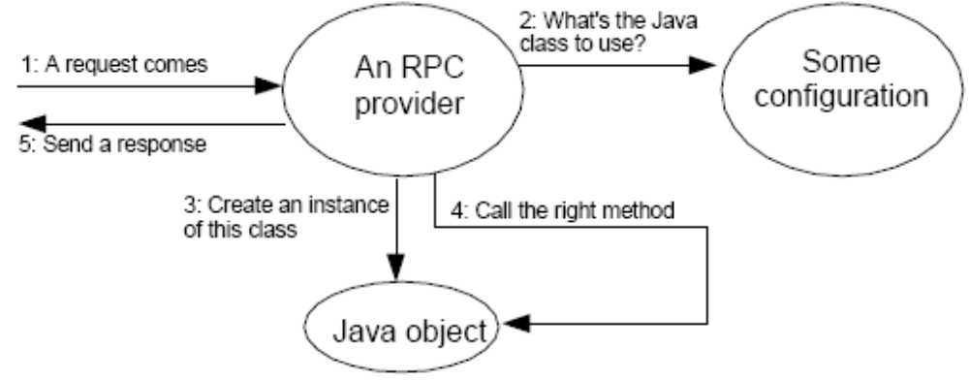
RPC Provider
a provider is the object that first receives the request.
  org.apache.axis.providers.java.RPCProvider

Slide 21
Sending the deployment descriptor to the Axis server
Deploy services
  c:> java org.apache.axis.client.AdminClient deploy.wsdd
List deployed services
  c:> java org.apache.axis.client.AdminClient list

Slide 22
Undeploying a web service
c:> java org.apache.axis.client.AdminClient undeploy.wsdd
<undeployment xmlns="http://xml.apache.org/axis/wsdd/">
<service name="HelloWorld"/>
</undeployment>

Slide 23
Calling a web service without a client stub
HelloClient.java

Slide 24
Using WSDL with Axis
Web Service Description Language (WSDL) serves to describe Web Services in a structured way: the interface to the service, the data types it uses, and where the service is located.
Axis supports WSDL in three ways:
  When you deploy a service in Axis, users may then access your service's URL with a standard web browser and by appending "?WSDL" to the end of the URL, they will obtain an automatically-generated WSDL document which describes your service.
  Axis provides a "WSDL2Java" tool which will build Java proxies and skeletons for services with WSDL descriptions.
  Axis provides a "Java2WSDL" tool which will build WSDL from Java classes.

Slide 25
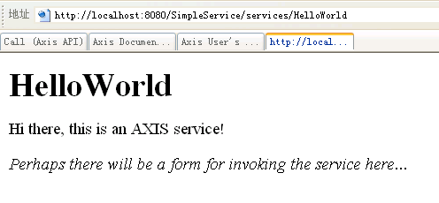
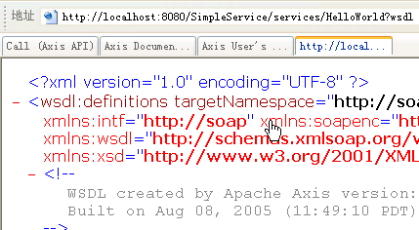

Slide 26
WSDL2Java
Building stubs, skeletons, and data types from WSDL
  C:> java org.apache.axis.wsdl.WSDL2Java (WSDL-file-URL)
<soapenv:Body>
…
</soapenv:Body>
Stub
Endpoint: http://...
Format: SOAP
Protocol: HTTP
Your code
1:Call sayHello()
2: Create a SOAP message
3: Send the SOAP message
to the endpoint
Web service
5: Convert the returned XML
element into a Java string
4: Send a response message back to the stub

Slide 27
Client Supporting Class
WSDL2Java generated:
  HelloWorld.java
  HelloWorldSoapBindingStub.java
  HelloWorldService.java
  HelloWorldServiceLocator.java
Client using stub
  soap.client.HelloUsingStub.java

Slide 28
WSDL
Example: EchoServer.wsdl
Message and Part:
  a method call is called an "input message" and a parameter is called a "part". The return value is called an "output message“
Port type
  A port type is like a Java interface, operations are grouped into one or more "port types“
Binding
  A Binding defines the message format and transport protocol used
Services: web services
  Port: defines the endpoint address.

Slide 29
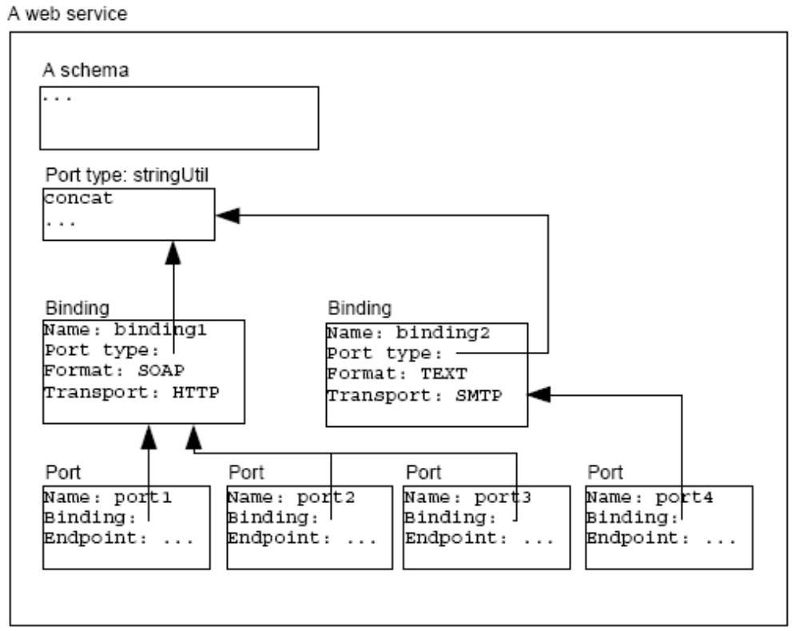
Port Example

